Slide 1
Big Mountain Resort

Slide 2
Introduction
Big Mountain Resort, a ski resort located in Montana, offers spectacular views of Glacier National Park and Flathead National Forest, with access to 105 trails. Every year about 350,000 people ski or snowboard at Big Mountain. This mountain can accommodate skiers and riders of all levels and abilities.

Slide 3
Problem Statement
Big Mountain Resort has recently installed an additional chair lift to help increase the distribution of visitors across the mountain. This additional chair increases their operating costs by $1,540,000 this season. There's a suspicion that Big Mountain is not capitalizing on its facilities as much as it could. The business wants some guidance on how to select a better value for their ticket price to maximize the profit and cover the additional cost. Additionally, They are also considering a number of changes that they hope will either cut costs without undermining the ticket price or will support an even higher ticket price.

Slide 4
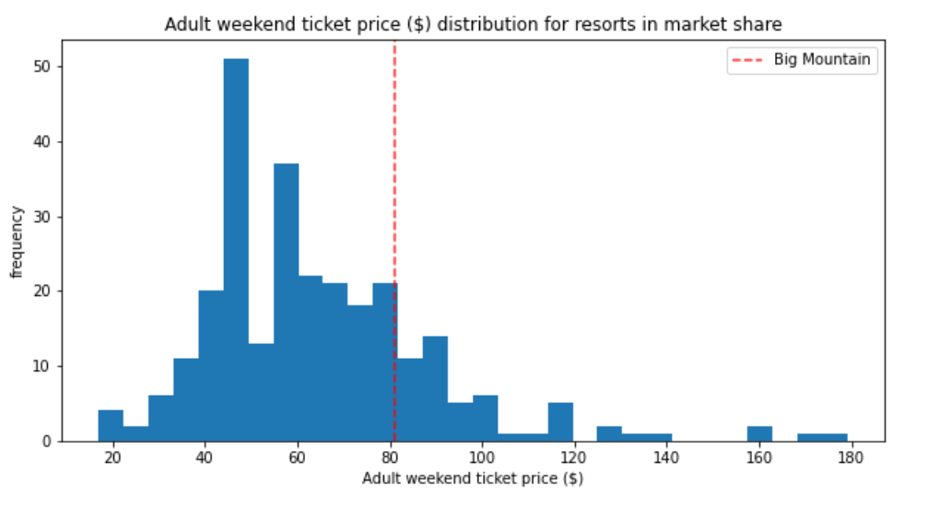
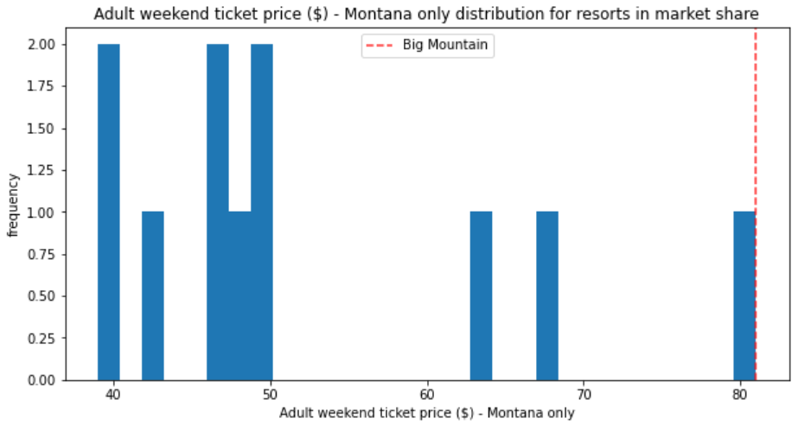
Big Mountain vs other resorts
Big Mountain Resort price vs all states
Big Mountain Resort price vs Montana Resorts

Slide 5
Features that came up as important in the modeling
vertical_drop
Snow Making_ac
total_chairs
fastQuads
Runs
LongestRun_mi
trams
SkiableTerrain_ac

Slide 6
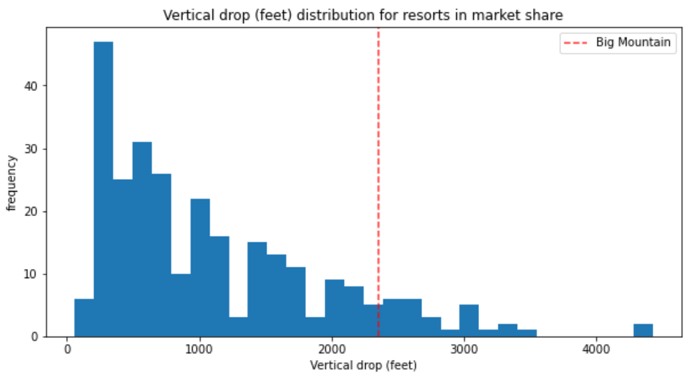
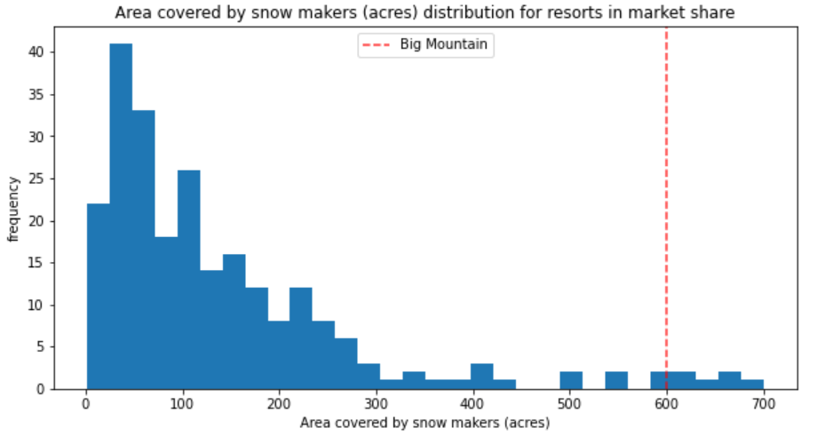
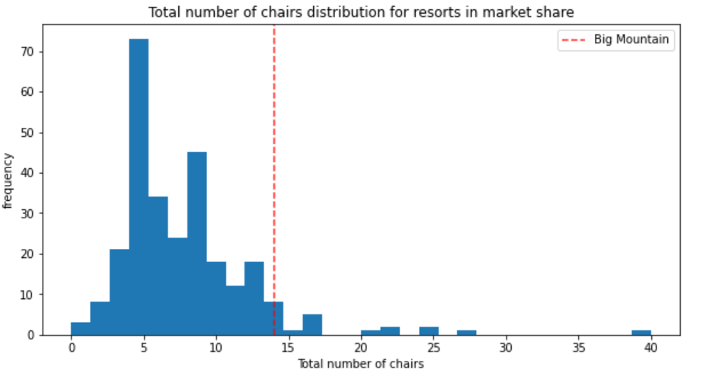
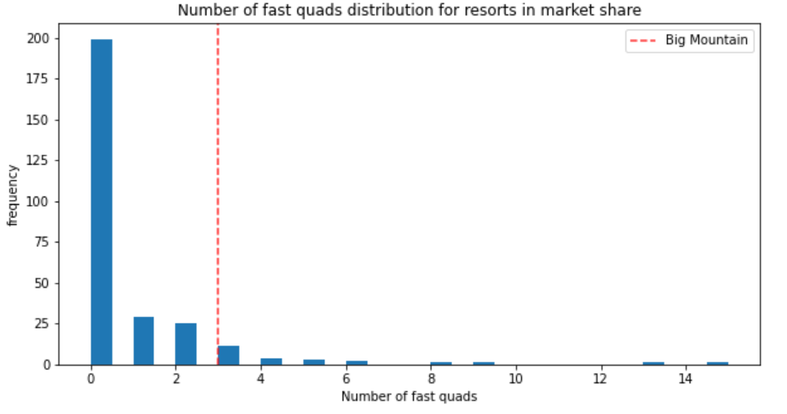
Big Mountain is doing well for vertical drop, but there are still quite a few resorts with a greater drop.
Big Mountain is very high up the league table of snow making area.
Big Mountain has amongst the highest number of total chairs, resorts with more appear to be outliers.
Most resorts have no fast quads. Big Mountain has 3, which puts it high up that league table. There are some values much higher, but they are rare.

Slide 7
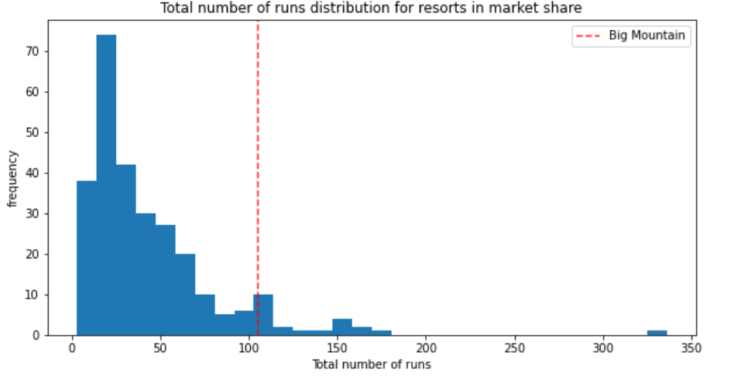
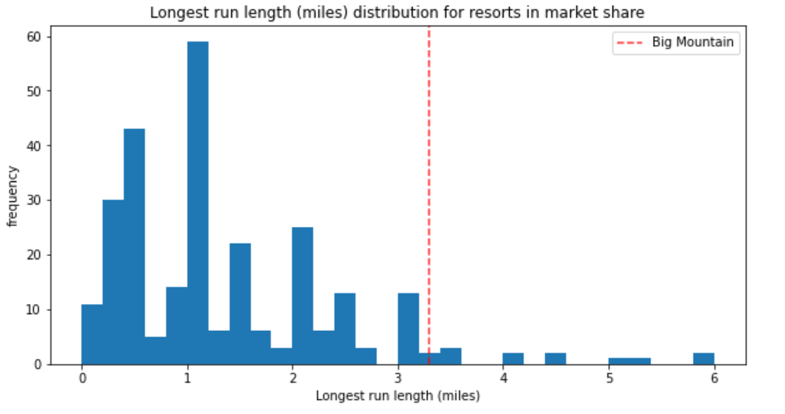
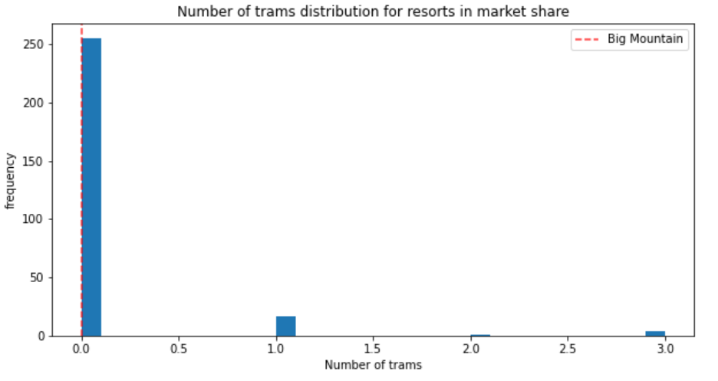
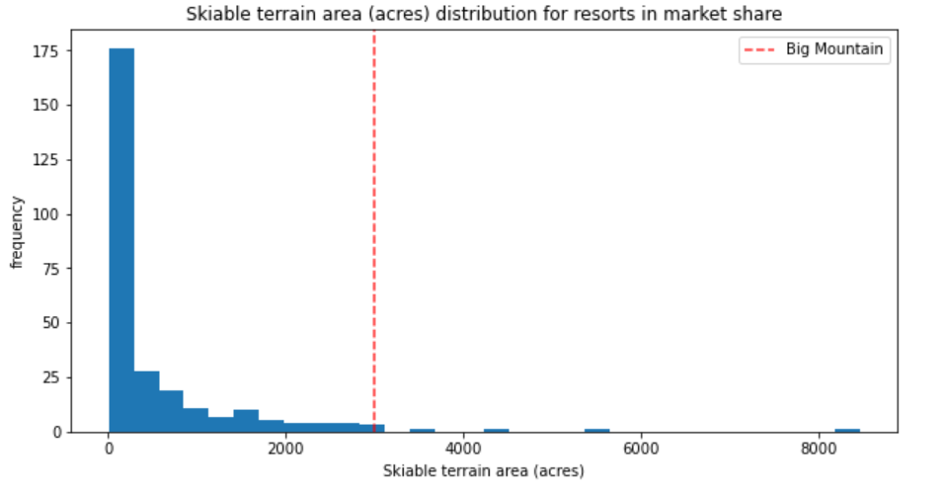
Big Mountain compares well for the number of runs. There are some resorts with more, but not many.
Big Mountain has one of the longest runs. Although it is just over half the length of the longest, the longer ones are rare.
The vast majority of resorts, such as Big Mountain, have no trams.
Big Mountain is amongst the resorts with the largest amount of skiable terrain.

Slide 8
Strategies options
Permanently closing down up to 10 of the least used runs. This doesn't impact any other resort statistics.
Increase the vertical drop by adding a run to a point 150 feet lower down but requiring the installation of an additional chair lift to bring skiers back up, without additional snow making coverage
Same as number 2, but adding 2 acres of snow making cover
Increase the longest run by 0.2 mile to boast 3.5 miles length, requiring an additional snow making coverage of 4 acres

Slide 9
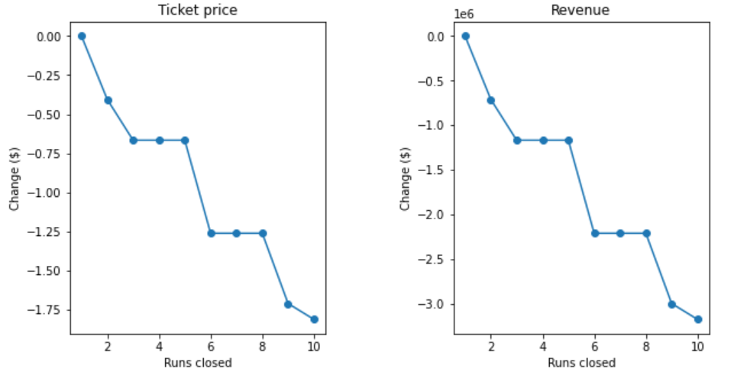
Scenario 1) Dropping Runs
closing one run makes no difference.
Closing 2 and 3 successively reduces support for ticket price and so revenue. close down 4 or 5 as there's no further loss in ticket price.
Increasing the closures down to 6 or more leads to a large drop
Scenario 2) adding a run, increasing the vertical drop by 150 feet, and installing an additional chair lift
This scenario increases support for ticket price by $1.99
Over the season, this could be expected to amount to $3474638
Scenario 3) adding a run, increasing the vertical drop by 150 feet, and installing an additional chair lift but adding 2 acres of snow making
This scenario increases support for ticket price by $1.99
Over the season, this could be expected to amount to $3474638
Such a small increase in the snow making area makes no difference!

Slide 10
Summary
Installing additional chair lift. This scenario increases support for ticket price by $1.99 Over the season, this could be expected to amount to $3474638
Come up with more strategies
Add more data and features

